Slide 1



NLP FOR AMAZON BOOK REVIEWS
Dhruv Shah | Jenn Hong | Santiago Mazzei | Setu Shah | Victor Floriano

Slide 2



BUSINESS OBJECTIVE
Our objective was to utilize advanced analytical techniques to enhance market segmentation, profiling, and user experience through in-depth analysis of book reviews.
CLUSTERING
Goal: Initiate the discovery of market segments and profiles through book review analysis.
Strategy: Employ clustering to systematically arrange data, revealing preliminary market insights.
K-MEANS & HIERARCHICAL CLUSTERING
Objective: Enhance the specificity of market segmentation and profiling using detailed criteria.
Focus Areas: Analysis centered around variables such as price, votes, and review volumes.
Advantages: Facilitates the identification of specific market niches and consumer behaviors.
TEXT MINING & SENTIMENT ANALYSIS
Aim: Categorize underlying sentiments within book reviews, and summarized the sentiment trends.
Methodology: Positive/negative sentiments classification, for a quick understanding of consumer opinions.
Outcome: Improves user engagement by presenting sentiment summaries.

Slide 3





OUR DATA
Reviews
Metadata
Final Columns
21 GB of Amazon Book Reviews sampled to 21,000 rows
Additional Metadata collected for Book Title, Genres & Pricing
After cleaning, our dataset now includes essential columns:
Overall Review Scores,
Review Verification Status,
Upvote Count,
Price,
Review Date.

Slide 4






EDA & CHALLENGES
Merged Datasets
Sampling
Merged Amazon product metadata to get additional columns such as Price, Title and Genre
We originally had 21 GB of data which we sampled using cloud computing
Missing Values
Feature Engineering
Imputed Price, Style & Vote. Dropped empty reviews generated due to tokenization
Added total review counts, month and year for each book for better clustering
Regex
Lemmatization
Cleaned Review text as well as Genre text using Regex
Chosen pre-processing technique

Slide 5




CLUSTERING ANALYSIS
01
02
DIMENSION REDUCTION
HIERARCHICAL VS. KMEANS
We applied Principal Component Analysis, but the results were not useful. To avoid loss of interpretability, we dropped it from our analysis.
We found that cluster characteristics, although distinct, were quite similar across both methods
03
CLUSTER CHARACTERISTICS
Clusters showed diverse behavior based on characteristics such as Price, Rating, Voting Engagement, and Genres

Slide 6
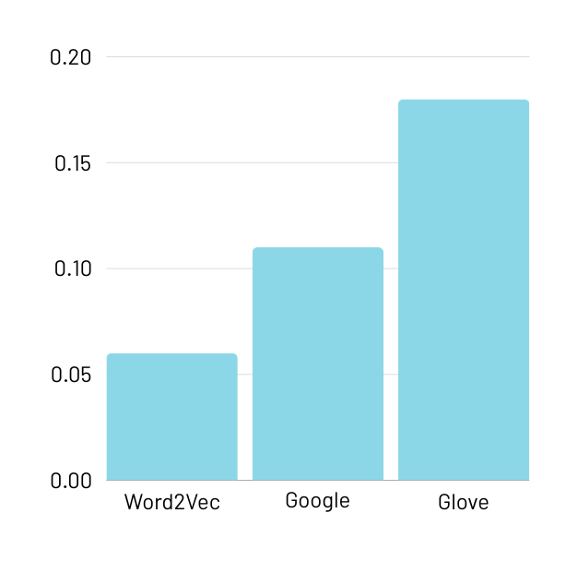
SENTIMENT ANALYSIS MODELS
Model Score: Effectiveness in differentiating between selected positive and negative reviews
Scores by Model
Model Score: 0.06
Trained on our own data
Evaluated 27 combinations of hyperparameters and picked the best.
01 - WORD2VEC
Model Score: 0.11
Pre-trained model
02 - WORD2VEC GOOGLE NEWS
Model Score: 0.18
Pre-trained model
Best performer, used to get a sentiment score for all reviews in the dataset
03 - GLOVE (300)

Slide 7




REVIEWS SENTIMENT
Top 3 Favorite Genres
Top 3 Favorite Books
Mean Sentiment by User Verification
Computers & Technology
Flesh House
Business & Money
The Complete Book of Greek Cooking
Arts & Photography
Mark Twain Audio CD Collection
Verified
Non-Verified

Slide 8






LIMITATIONS OF ANALYSIS
Different ASINs for Similar Books
Lacking in Statistical Significance
Difficult to accurately aggregate results and reviews across listings
Not enough statistical power to make definite conclusions, prudent to include more data for such analysis in the future
... AND
NEXT STEPS?
Aggregated Word Sentiment != Overall Review Sentiment
Measurement of Model Performance
Reviews that were clearly negative or positive can still contain many words on the opposite spectrum, which will dilute model results.
As model performance was only measured by one positive and one negative review, it could be more robust by using multiple reviews instead

Slide 9



CONCLUSION
Top performing genre, book styles and titles can inform recommendation algorithms for marketing strategies, content recommendation, and product development.
Publishers can plan production decisions, operations planning, and marketing strategies around top performing titles, genres and book styles as well.
Clustering identified two groups of power users
Adding sentiment review scores to the review interface for users can lead to greater understanding to make more informed purchases.
Reviewers with many votes of helpfulness
Purchasers of expensive, rare books

Slide 10
ANY QUESTIONS?

Slide 11
THANK YOU!

